Slide 1
Email Phishing Analysis Tool

Slide 2
TEAM
Technical provider : AMIT Learning
Instructor : Mohamed Ammar
By:
Abdulrahman Hamdy mohammed
Abobakr Ahmed Abdelghaffar
Ahmed Mohamed Gomaa
Yasser Khaled Ahmed

Slide 3
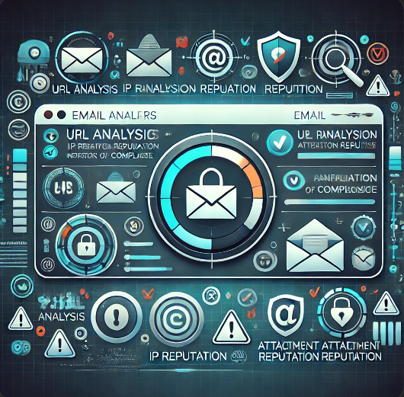
Table of contents
Email phishing
Problem Statement
How Does Email Phishing Detection Work?
Core Features
Email_header_analyzer.py
urls_Ip_and_Attachment Analysis.py
Email_IOC_analyzer.py
MAIN.py
Future Enhancements
Conclusion

Slide 4
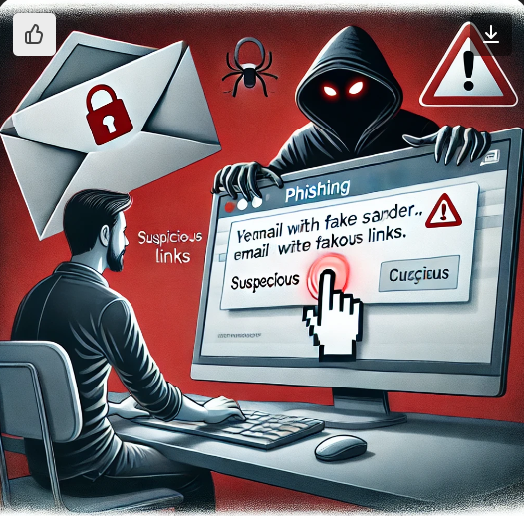
Introduction
Email phishing
It is a common cyber attack where malicious actors disguise themselves as trustworthy entities to trick recipients into giving up sensitive information.
These attacks often lead to identity theft, financial fraud, or data breaches, making them a significant threat to organizations and individuals.
SOC (Security Operations Center) analysts play a crucial role in identifying phishing attempts by analyzing email headers and attachments.

Slide 5
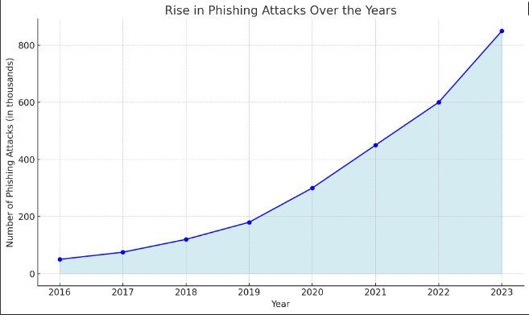
Problem Statement
SOC analysts often struggle with the tedious task of manually analyzing email headers and attachments to detect phishing attacks.
This process is not only time-consuming but also prone to errors.
Our tool simplifies this by making email headers more readable and automatically providing IP, URL, and attachment reputation analysis, enabling faster and more accurate phishing detection.

Slide 6
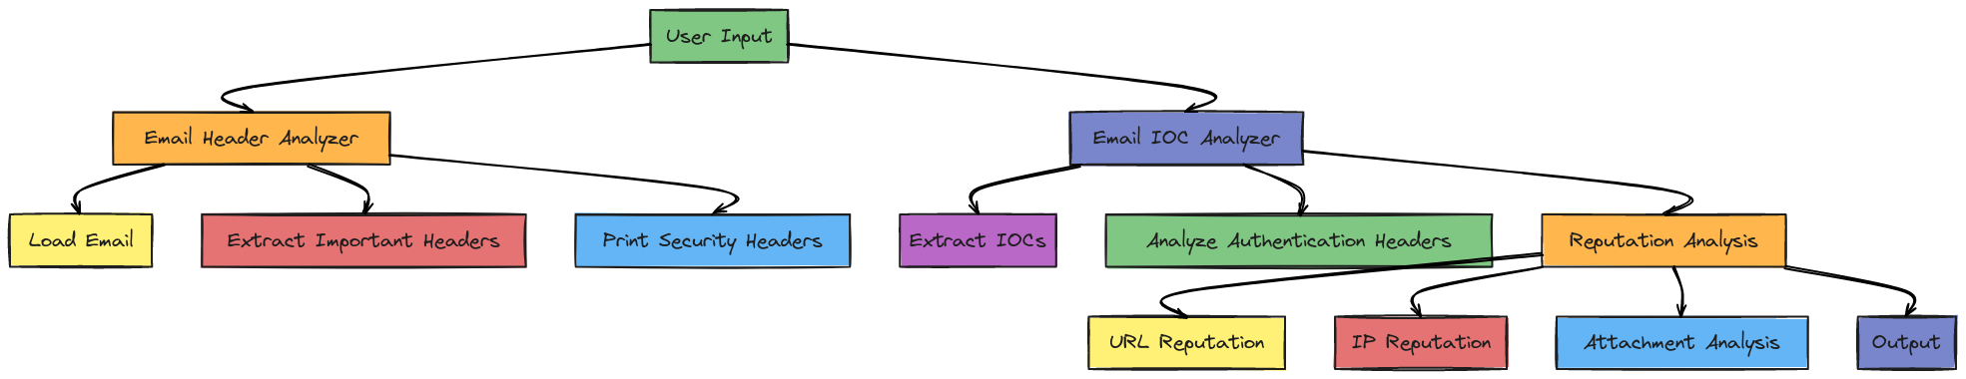
How It works
The Email Phishing Detection Tool automates the extraction and analysis of email headers and attachments.
It checks for suspicious elements like forged sender addresses, malicious URLs, and compromised attachments, helping SOC analysts quickly identify phishing attempts.

Slide 7
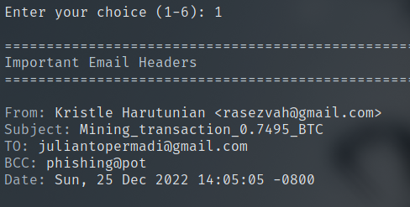
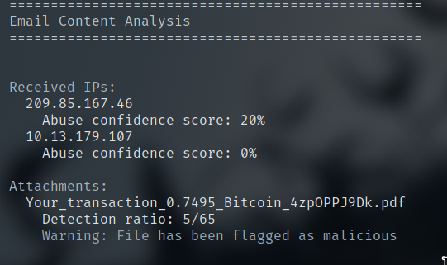
Core Features
Email Header Analysis: Detects sender IP, SPF, DKIM, and DMARC failures.
IOC Extraction: Extracts suspicious indicators like URLs, IPs, domains, and attachments.
Reputation Analysis: Checks URLs and IPs against VirusTotal and AbuseIPDB APIs for reputation scores.

Slide 8
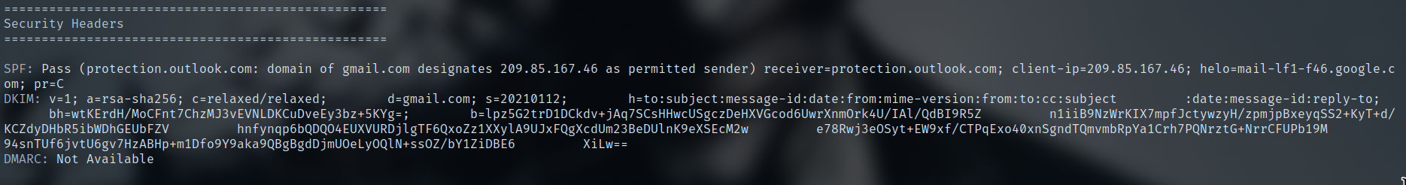
Email_Header_Analysis.py
Our tool examines critical parts of email headers such as the sender's IP address, SPF/DKIM/DMARC records, and email routing information.
This allows analysts to validate the sender's authenticity and detect any anomalies.

Slide 9
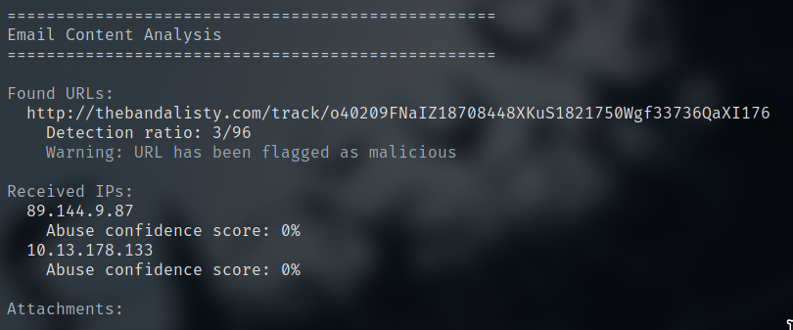
urls_Ip_and_Attachment Analysis.py
IP Addresses: It extracts IP addresses from email headers and checks their reputation using the AbuseIPDB API to flag suspicious or malicious IPs.
URLs: The tool scans URLs within the email content and checks their reputation against the VirusTotal API, identifying malicious or phishing websites.
Attachments: It analyzes email attachments, calculates their file hash, and checks the hash against the VirusTotal database to detect malware or known threats.

Slide 10
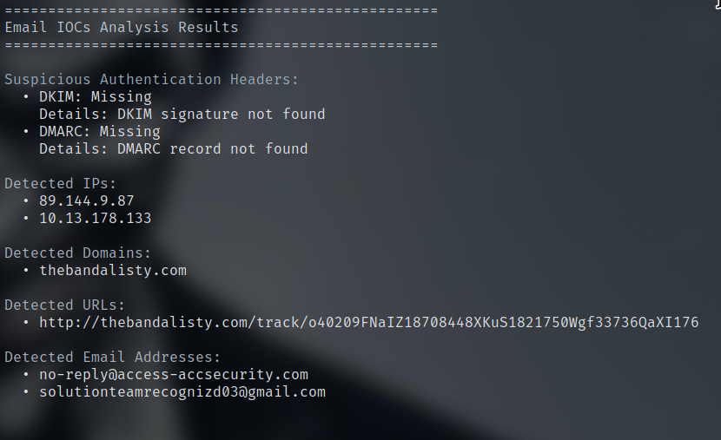
Email_IOC_analyzer.py
The code in the EmailIOCAnalyzer extracts Indicators of Compromise (IOCs) from emails, including IP addresses, domains, URLs, email addresses, and attachments.
It also analyzes important email authentication headers like SPF, DKIM, and DMARC to detect potential phishing or spoofing attempts.
The results are displayed, highlighting any suspicious elements found in the email

Slide 11
Main.py
Initialization of the Tool:
Sets up logging, directories, and initializes key components like the EmailHeaderAnalyzer, EmailIOCAnalyzer, and ReputationAnalyzer classes from other modules.
API Key Management:
Loads and saves API keys (VirusTotal, AbuseIPDB) from/to a config file.
If API keys are missing, the script prompts the user to input them and saves the keys for future use.
Email Analysis:
Load Email: The tool loads an email file (.eml) and parses it for analysis.
Interactive Menu:
Option 1: Prints important headers (e.g., From, To, Date, Subject).
Option 2: Prints security headers (SPF, DKIM, DMARC).
Option 3: Analyzes URLs, IPs, and attachments within the email
Option 4: Extracts and prints Indicators of Compromise (IOCs) such as suspicious IPs, domains, URLs, and attachments.

Slide 12
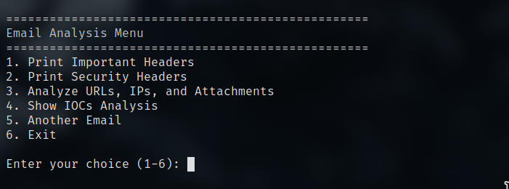
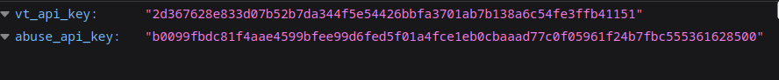
Main.py

Slide 13
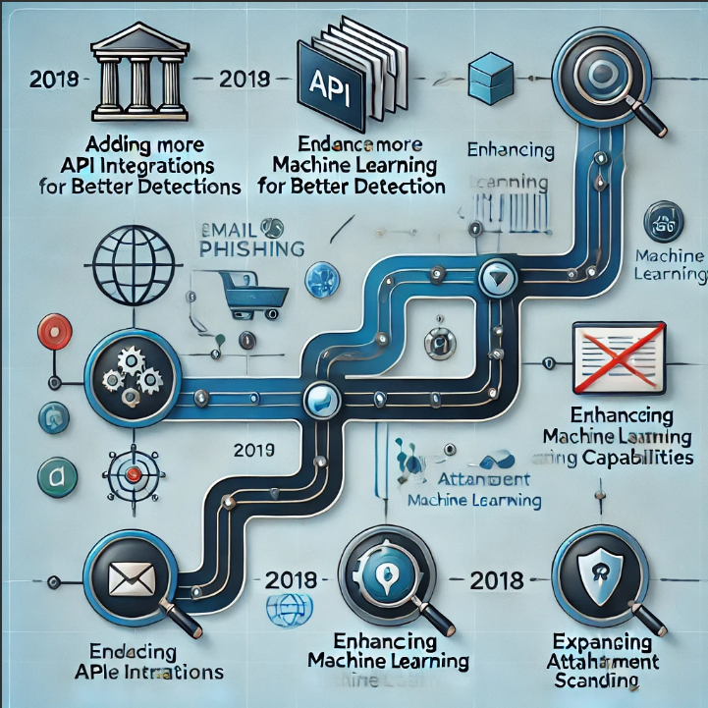
Future Enhancements
Adding support for more APIs for deeper analysis.
Enhancing machine learning to detect phishing more accurately.
Expanding attachment scanning capabilities to include more file types.

Slide 14
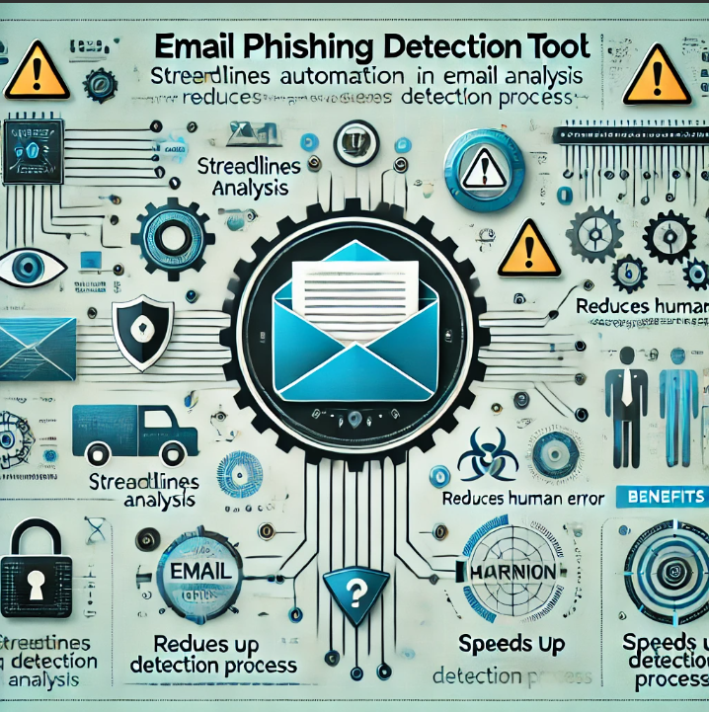
Conclusion
The Email Phishing Detection Tool streamlines the analysis of phishing emails, allowing SOC analysts to detect and respond to phishing threats more efficiently.
Its automation reduces human error and speeds up the detection process.

Slide 15
LINKS
GIthub Link for the Tool:
https://github.com/apdoel/Phishing_Email_Analysis.git

